Slide 1
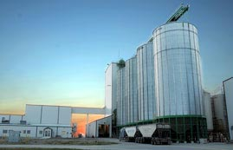
Milling Oat Quality and End Use Performance Requirements CNMA Meeting September 2016
Terry Tyson
Grain Procurement Manager
Grain Millers Canada Corp.

Slide 2
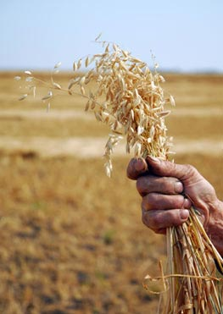
Oats – Quality & End Use Performance
Key differences between oats and wheat:
No class distinctions – oats are oats
DON is typically removed with hulls
Breadth of end-uses is smaller
Results in more consistent end
user demands in terms of core
quality
Physical
Functional
Nutritional

Slide 3
Oats – Breeding for Quality & End Use
As a result, the oat industry is able to breed for many of our quality and end-user requirements
Breeding Programs funded by combination of institutional / industry money
Industry takes a very active role, sitting at the table with breeders
POBC
CDC
Oat cultivars - 2 years in Western Co-op Trials
In effect, cultivars are vetted for 3 or 4 years by industry

Slide 4
Current Breeding Objectives
Breeders seek to create varieties that will advance various and specific aspects of the crop, while conforming to the three major facets of the industry’s quality control policies
Agronomy / Disease
Milling Nutritional
Properties Characteristics

Slide 5
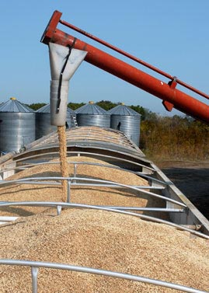
Breeding Objectives
Milling Properties effect end use quality
Visually appealing product
Desirable absorption levels
Predictable functionality
Agronomy needs to be there so farmers will grow it
But Nutritionals have grown significantly in importance

Slide 6
End Use Nutritional Requirements
Heart Healthy Labeling and the “Health Halo” that oats has enjoyed have been primary drivers of market growth
Beta Glucan – in excess of 4% in raw oat groat
Total Dietary Fibre – in excess of 10% in raw oat groat
Protein – in excess of 11.5% in raw oat groat
Oil – below 7% in raw oat groat
These have gone from desirable to “deal breaker” in the last decade.

Slide 7
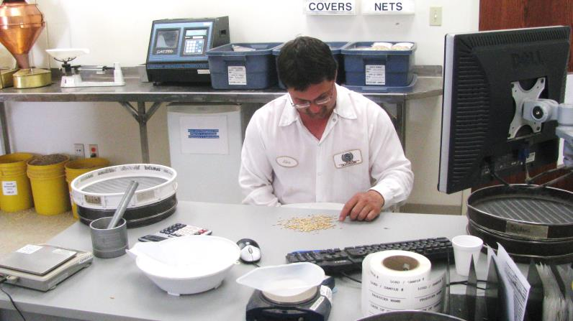
Beyond Breeding
Customer expectations go beyond regulatory compliance
General Food Safety
OTA
GE Attestations
Allergens
Differentiation
Clean Labels
Niche claims / footholds
IP

Slide 8
General Food Safety
Global Food Safety Initiative (GFSI)
Standardization of 3rd-party audits
BRC Certification
HACCP-based
Marketplace requirement for at least 5 years
What differences are there between GFSI protocols and FSMA / SFCA requirements?

Slide 9
Ochratoxin A
OTA continues to challenge the oat industry
Proposed MLs have become expectations of the marketplace
5.0 ppb / 3.0 ppb in grain not a major hurdle
0.5 ppb in infant food is a challenge
Measuring to that level (with confidence) is onerous
Managing to that level is very difficult
Has led to development of IP programs designed with best efforts to eliminate proliferation of the toxin
*who pays??

Slide 10
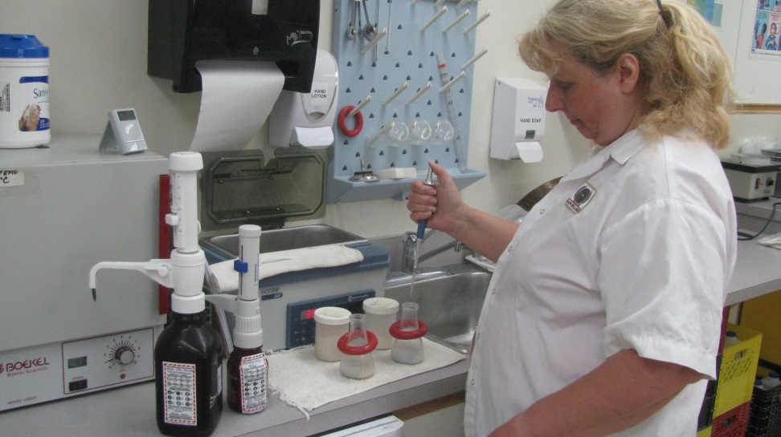
GE Presence / Allergens
The question of Adventitious Presence
As with wheat millers, end users of oat products often ask for attestations from oat suppliers regarding the lack of presence of genetically engineered material
Careful wording!
Allergens – soy, mustard,
wheat
May Contain statements
Gluten-Free – niche market
IP oats / proprietary milling
processes

Slide 11
Differentiation
Desire to differentiate from competitors in a flat cereal market has perhaps become the biggest driver of end-user requirements in recent years.
Driven by consumer desire for clean labels
Some aspect of distrust for “big food”
More IP demand – variety, nutritional components,
production practices
- pre-harvest glyphosate is an example
More programs requiring direct interface with
growers – linking consumer to farmer

Slide 12
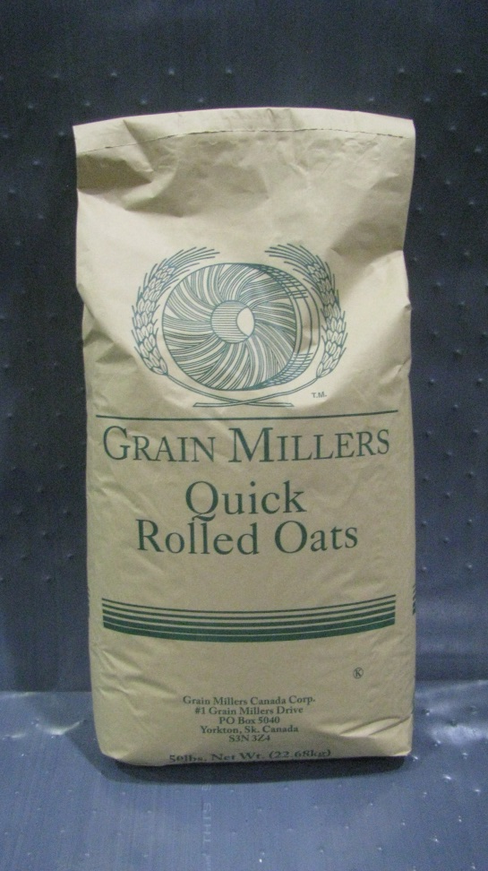
Defining Quality and End User Requirements becomes a little more complex all the time
Functionality
Regulatory
Consumer Driven
Naturally aligned - drives self-regulation / continuous improvement from within
Continued strong voice for the industry / relationship with regulators an imperative

